Slide 1
Distributed File Storage
Shashi Shekhar
Raja Nageswara Rao Gogineni

Slide 2
Algorithms used
Distributed hash table
Consistent hashing
Chord (Peer to peer)

Slide 3


Functionalities
Availability
Scalability
Fault tolerance
Decentralized peer to peer
Consistency
In memory file transfer similar to spark

Slide 4
Major challenges faced
When removing a node or if a crash happened transferring of resources
Maintaining replication table when adding a node or removing a node
Moving from centralized file storage to decentralized file storage

Slide 5
Complexities for file transfer
Add a node: O(n)
Removing a node: O(n log n)
Download/Upload files: O(log n)
Replication Factor
Number of replicas are kept as 2 to avoid various complexities involving file redistribution.

Slide 6
Future work
Integration of peer to peer file transfer with mobiles
Dealing with dynamic increment of replication factor(Lack of time)
Implement peer to peer file system, and additional functionalities like ls, folders ...

Slide 7
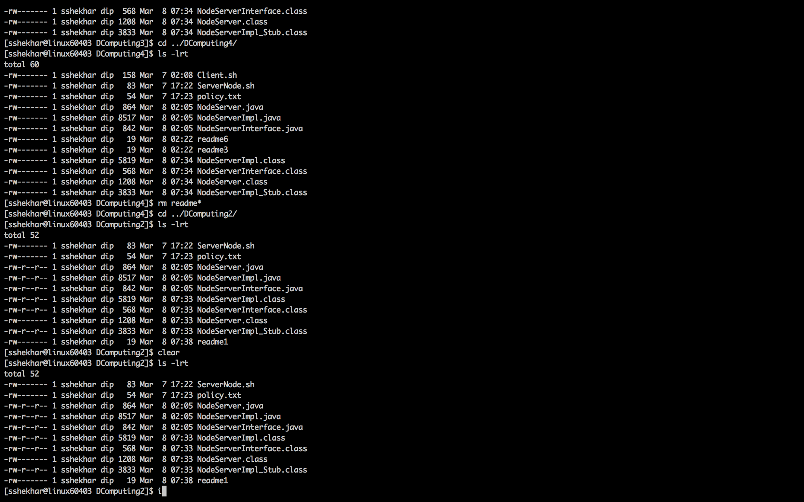

Slide 8
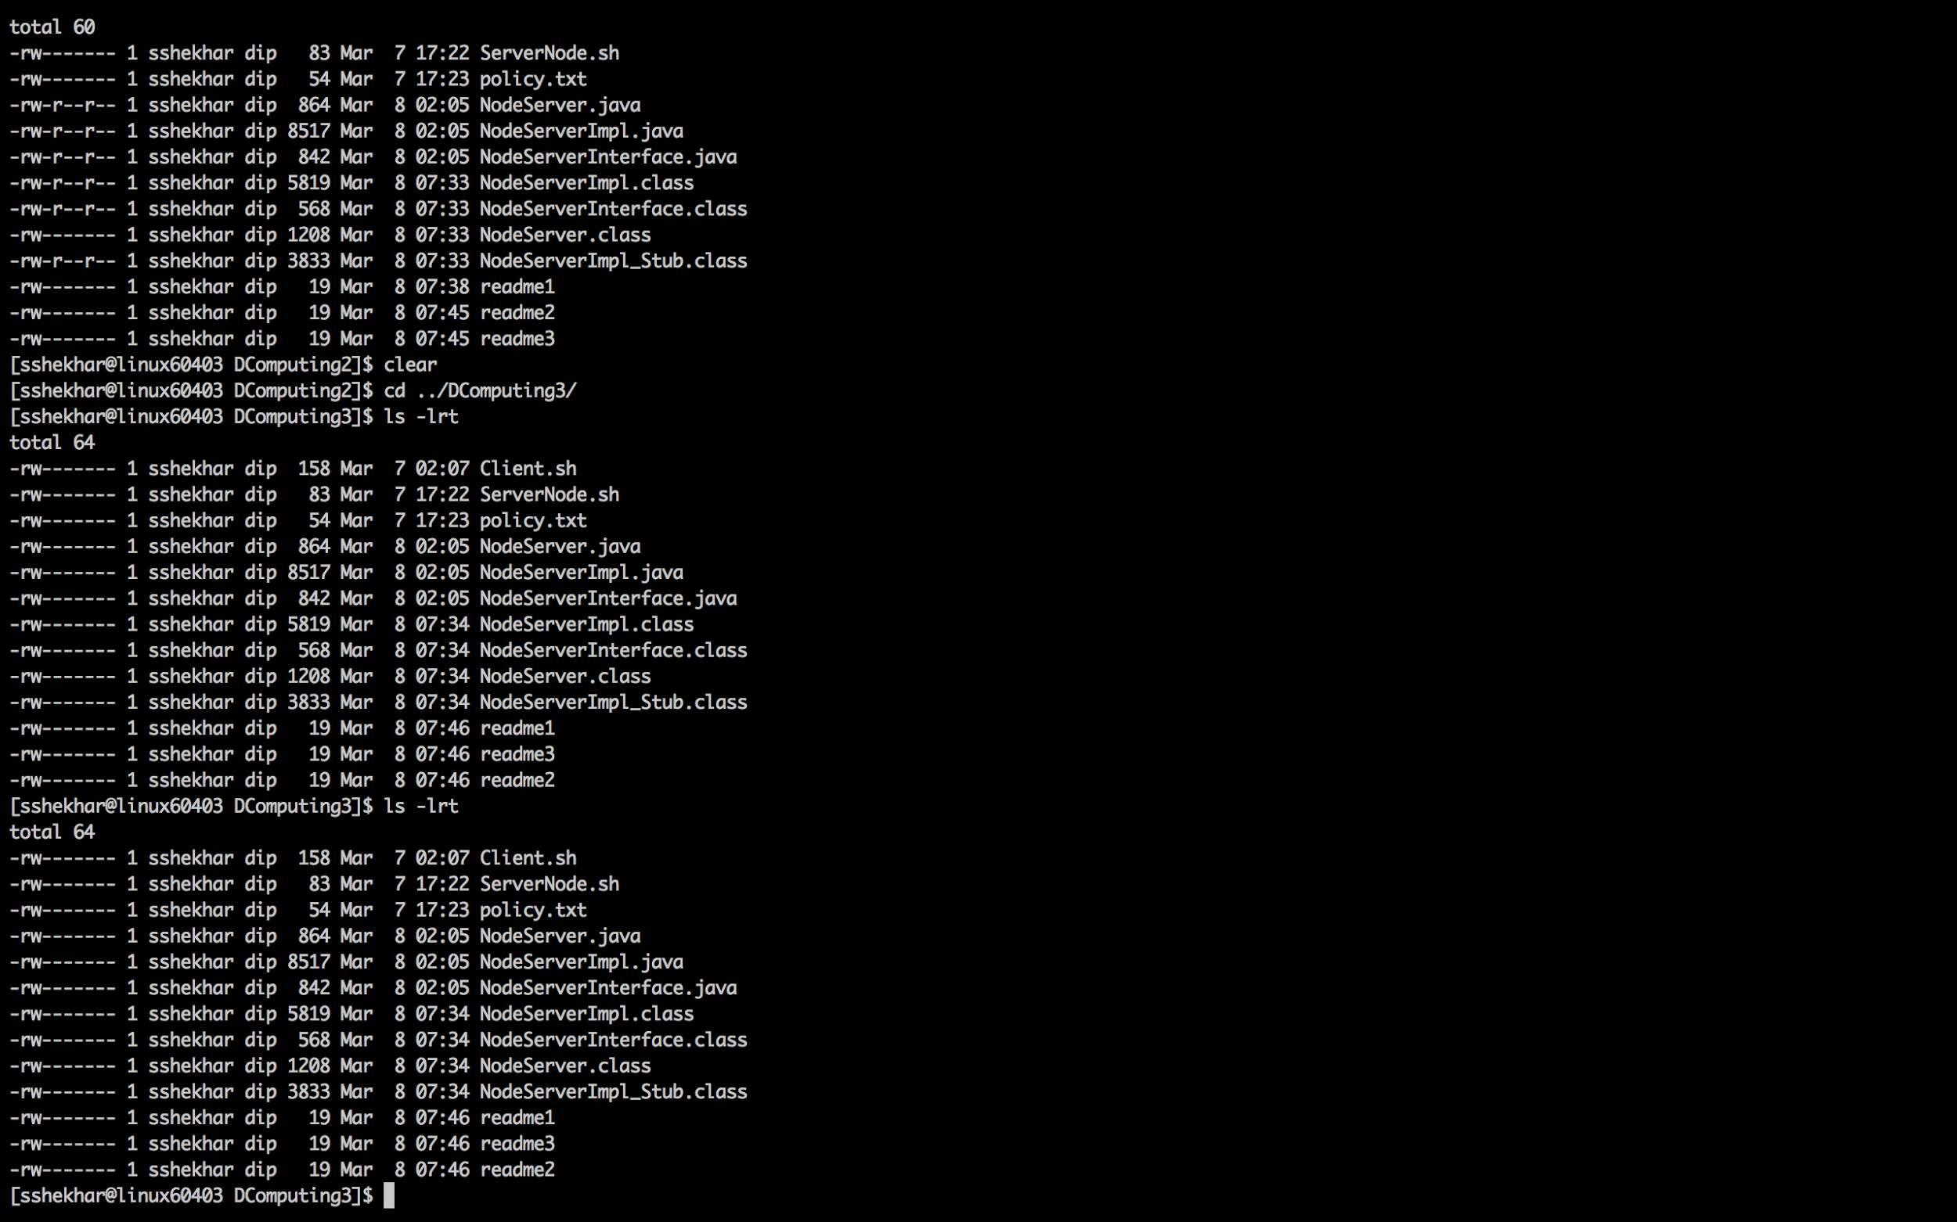

Slide 9
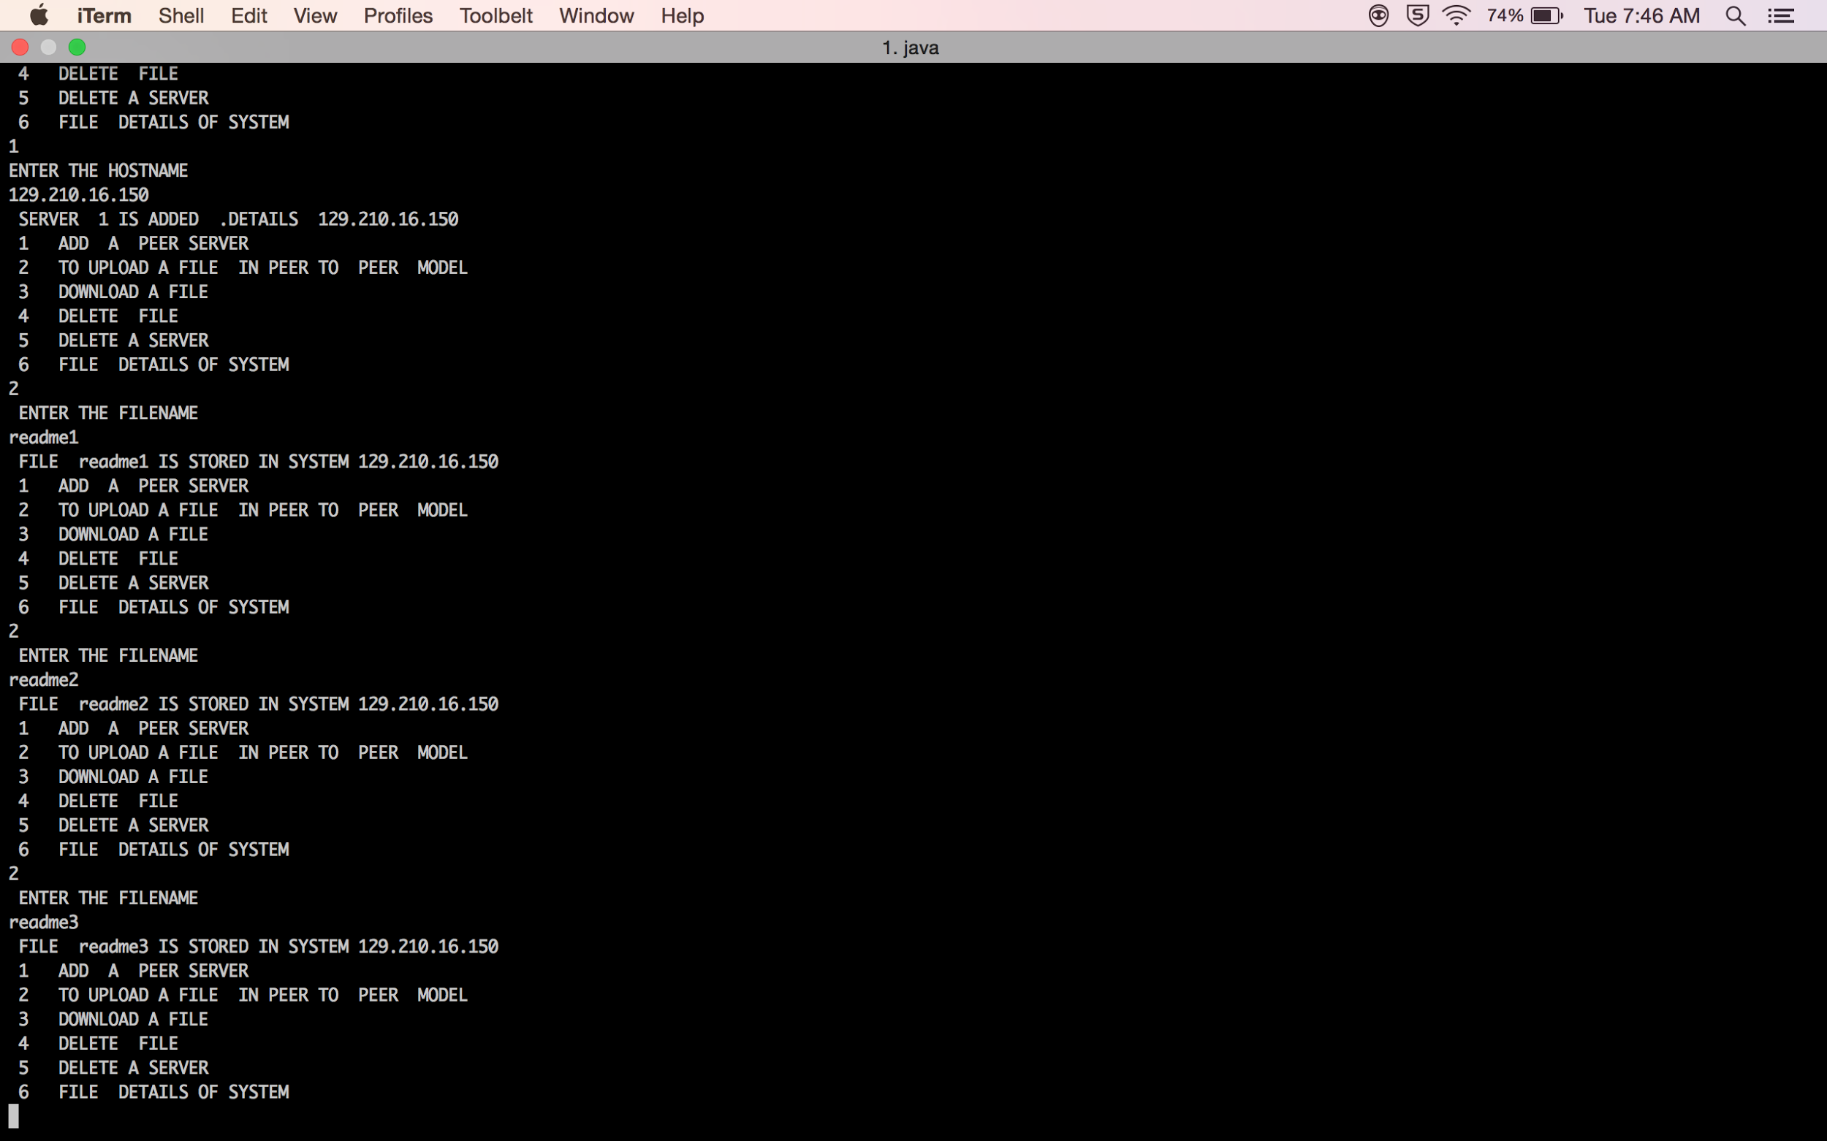

Slide 10
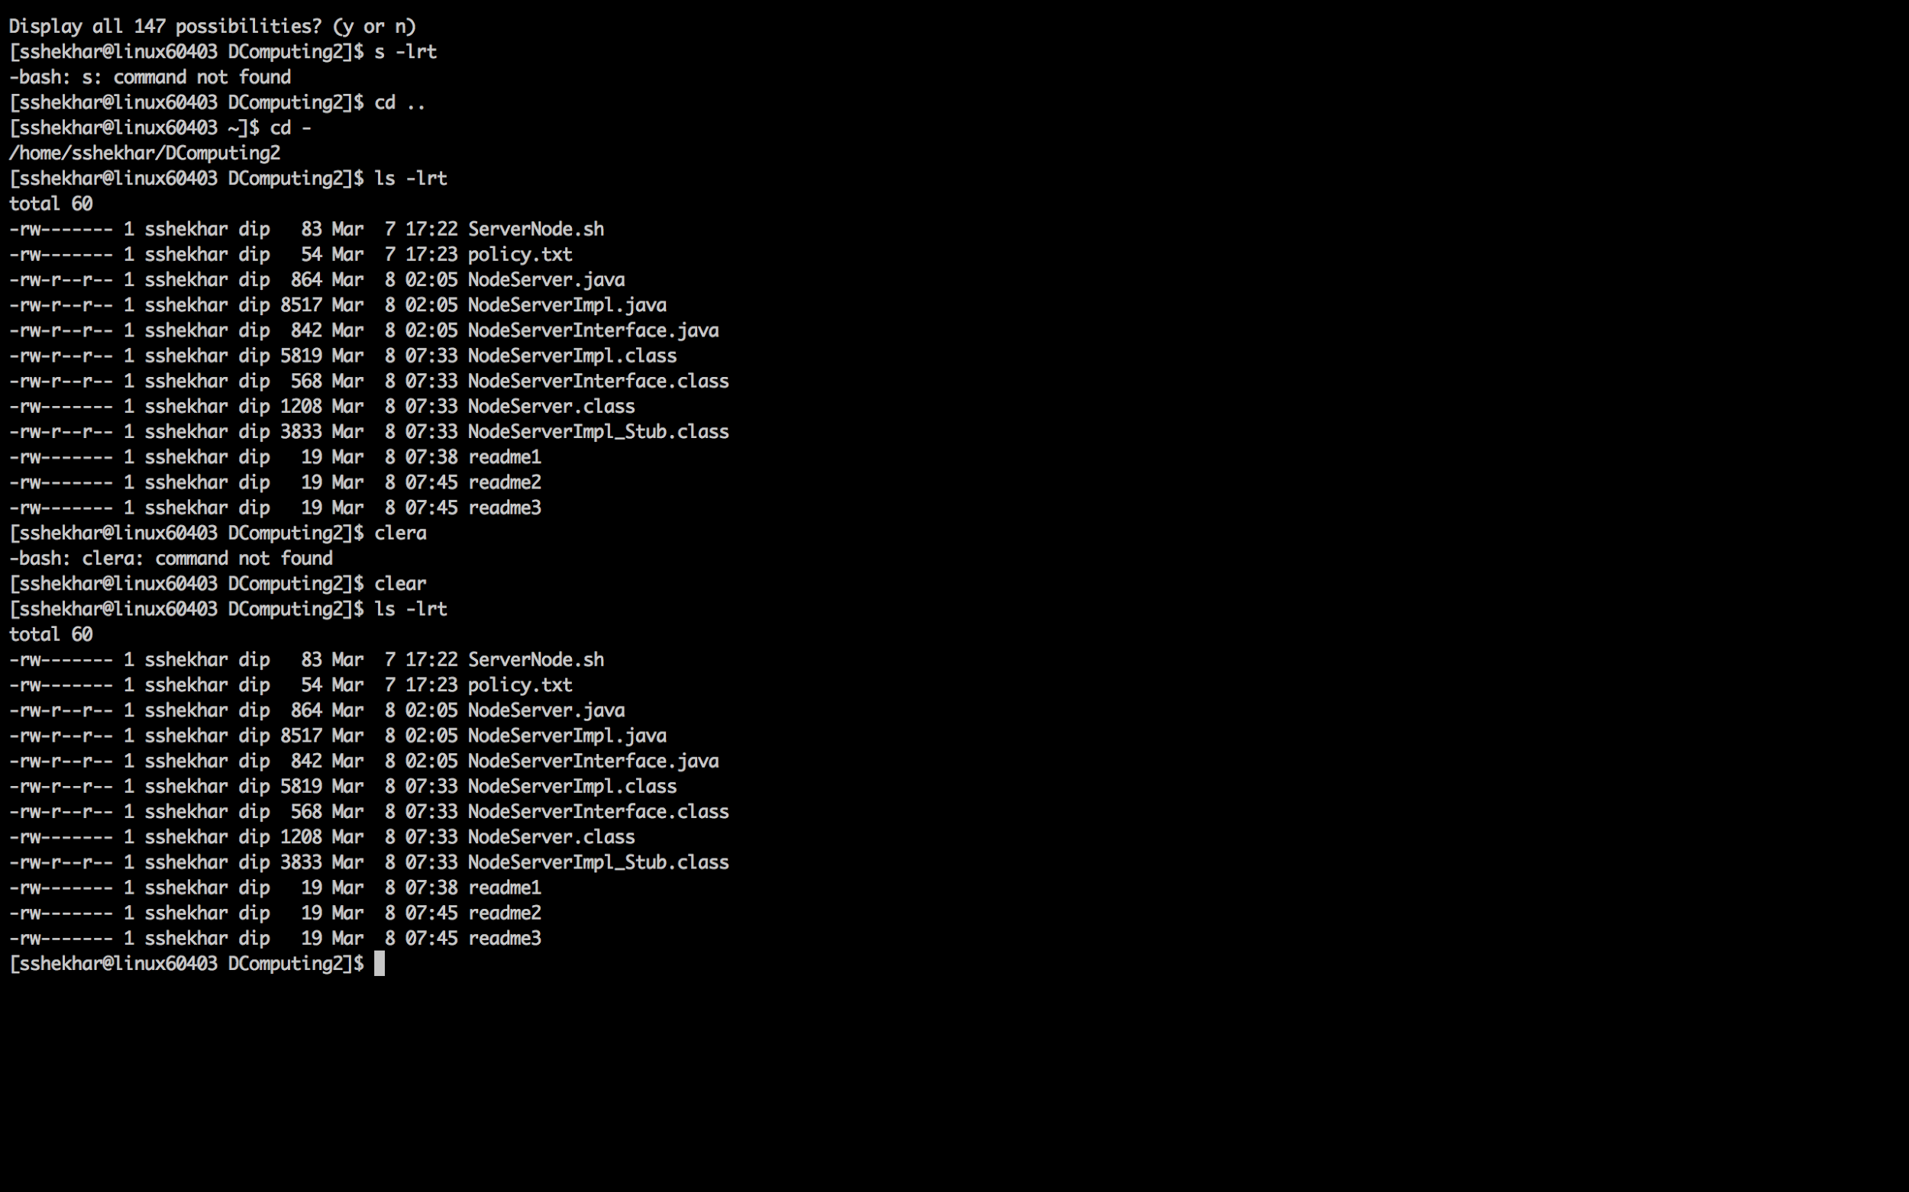

Slide 11
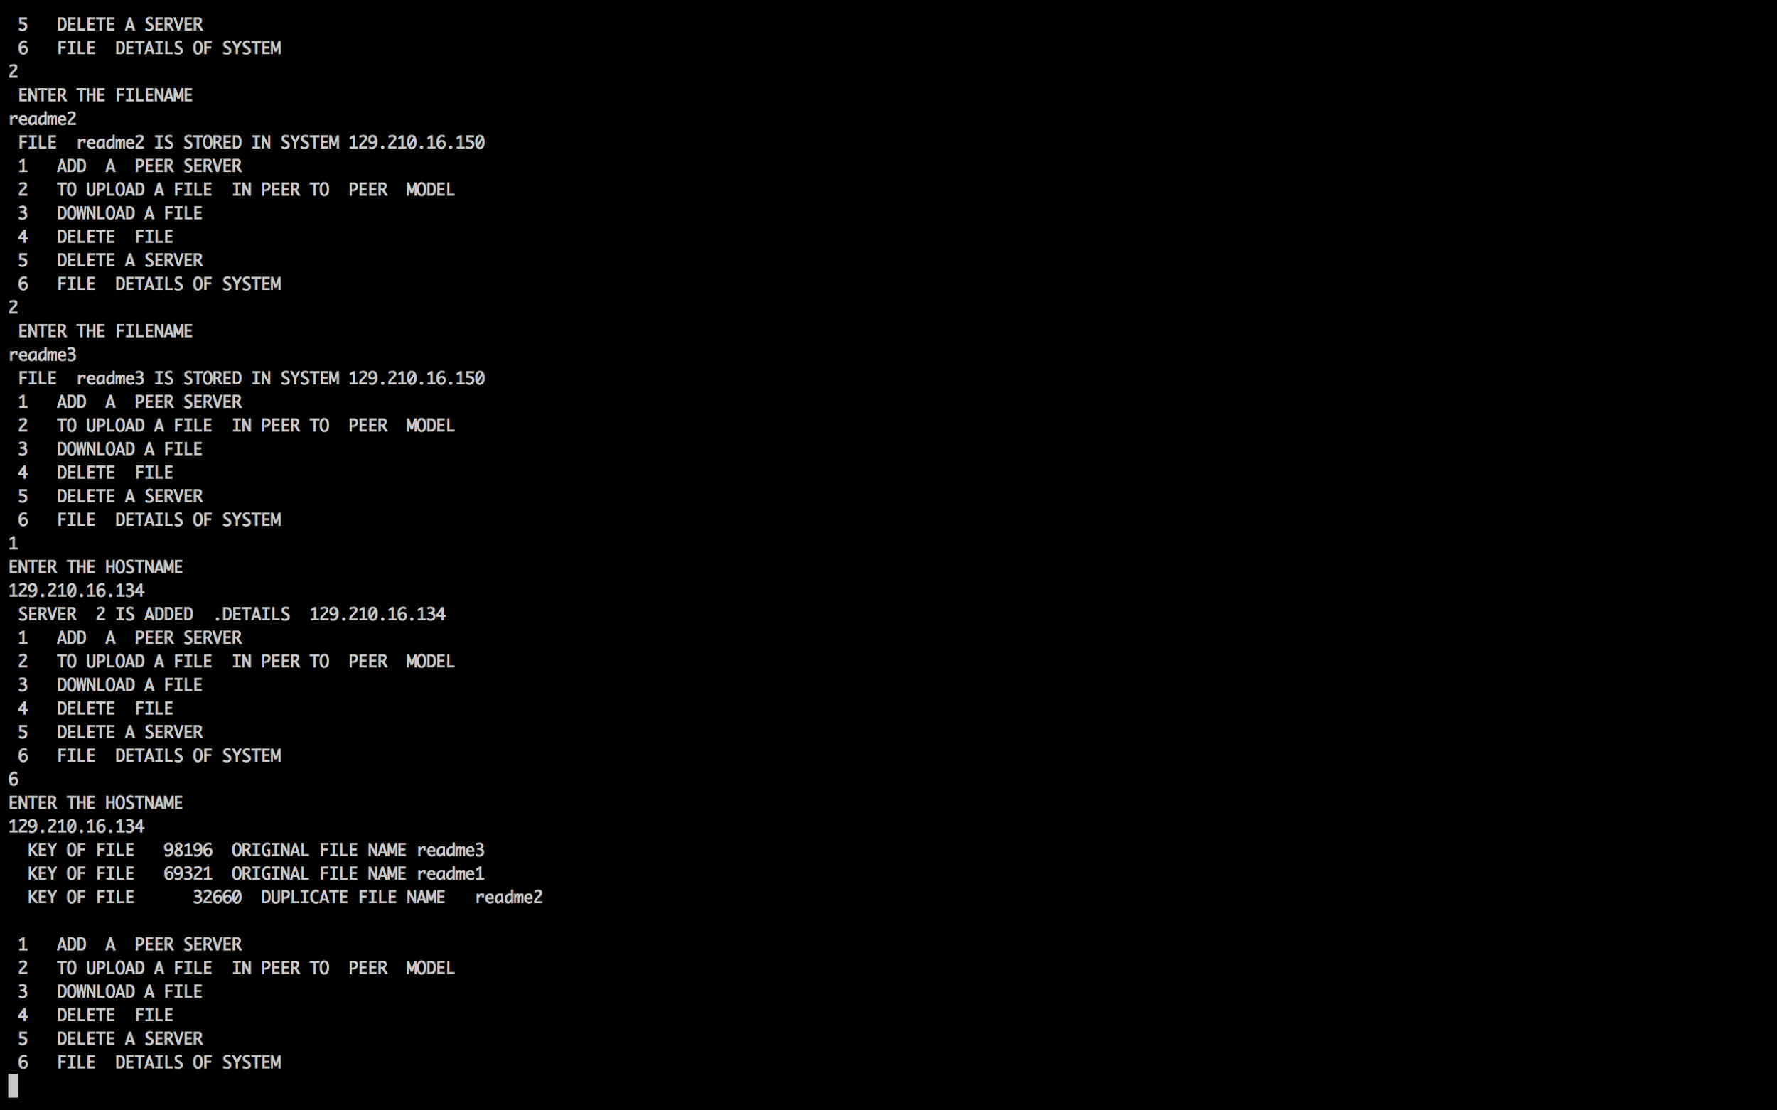

Slide 12
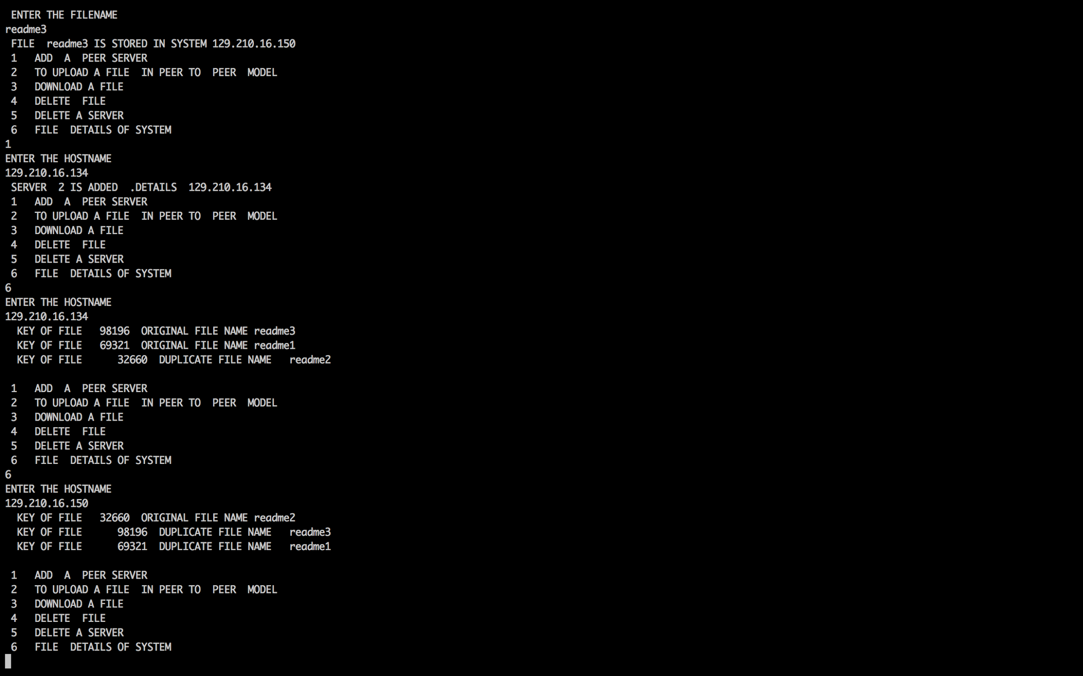

Slide 13
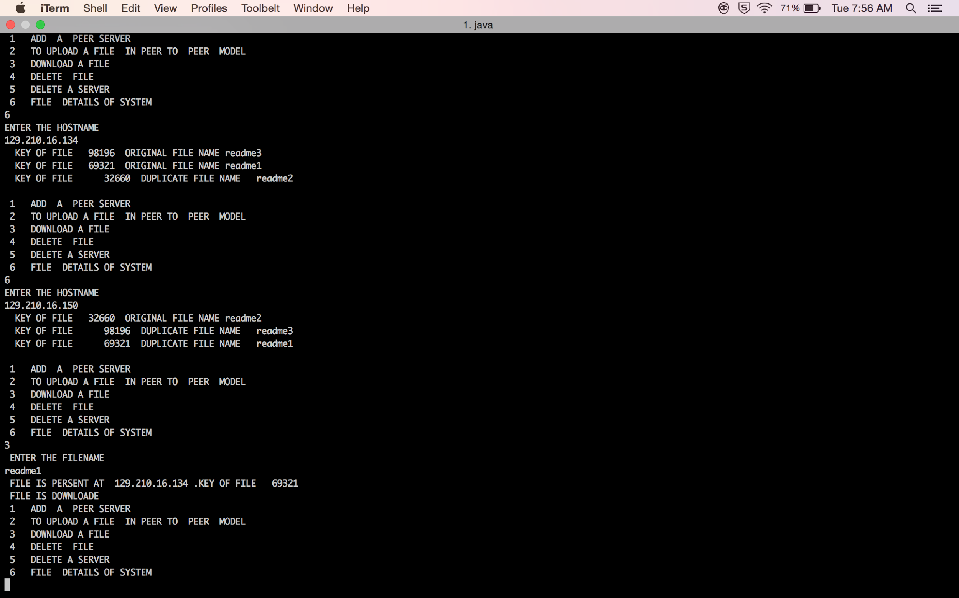

Slide 14
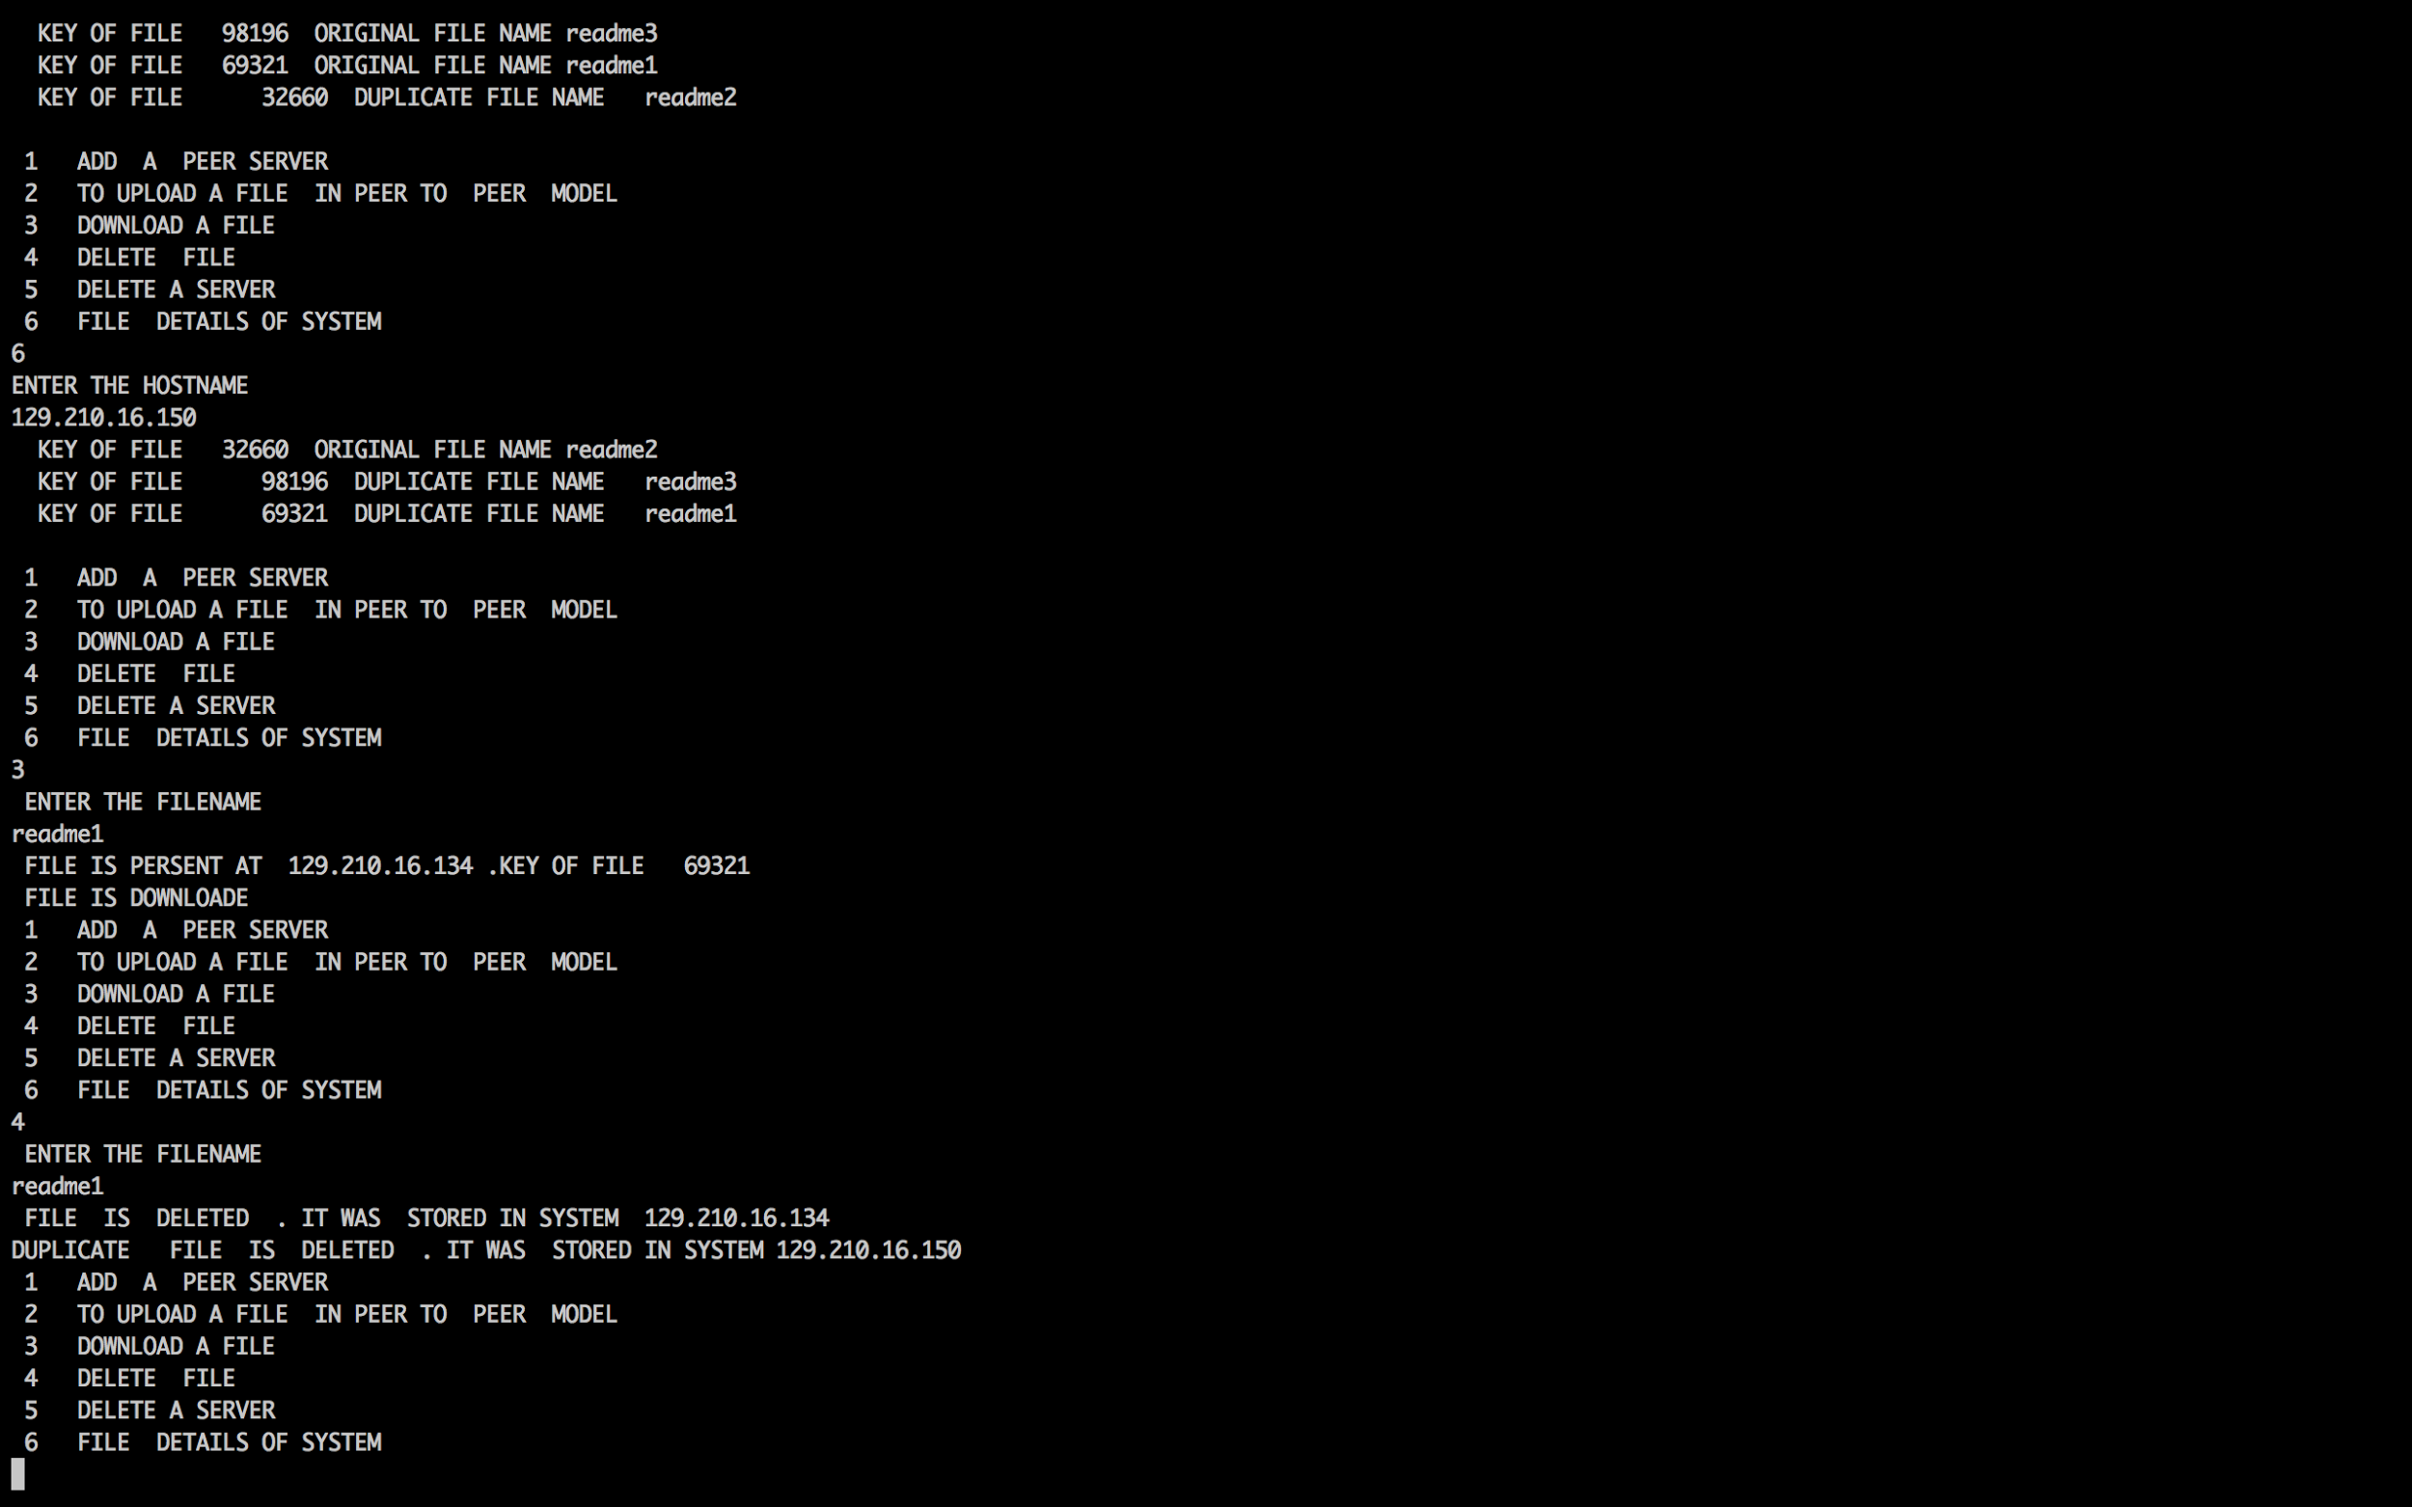

Slide 15
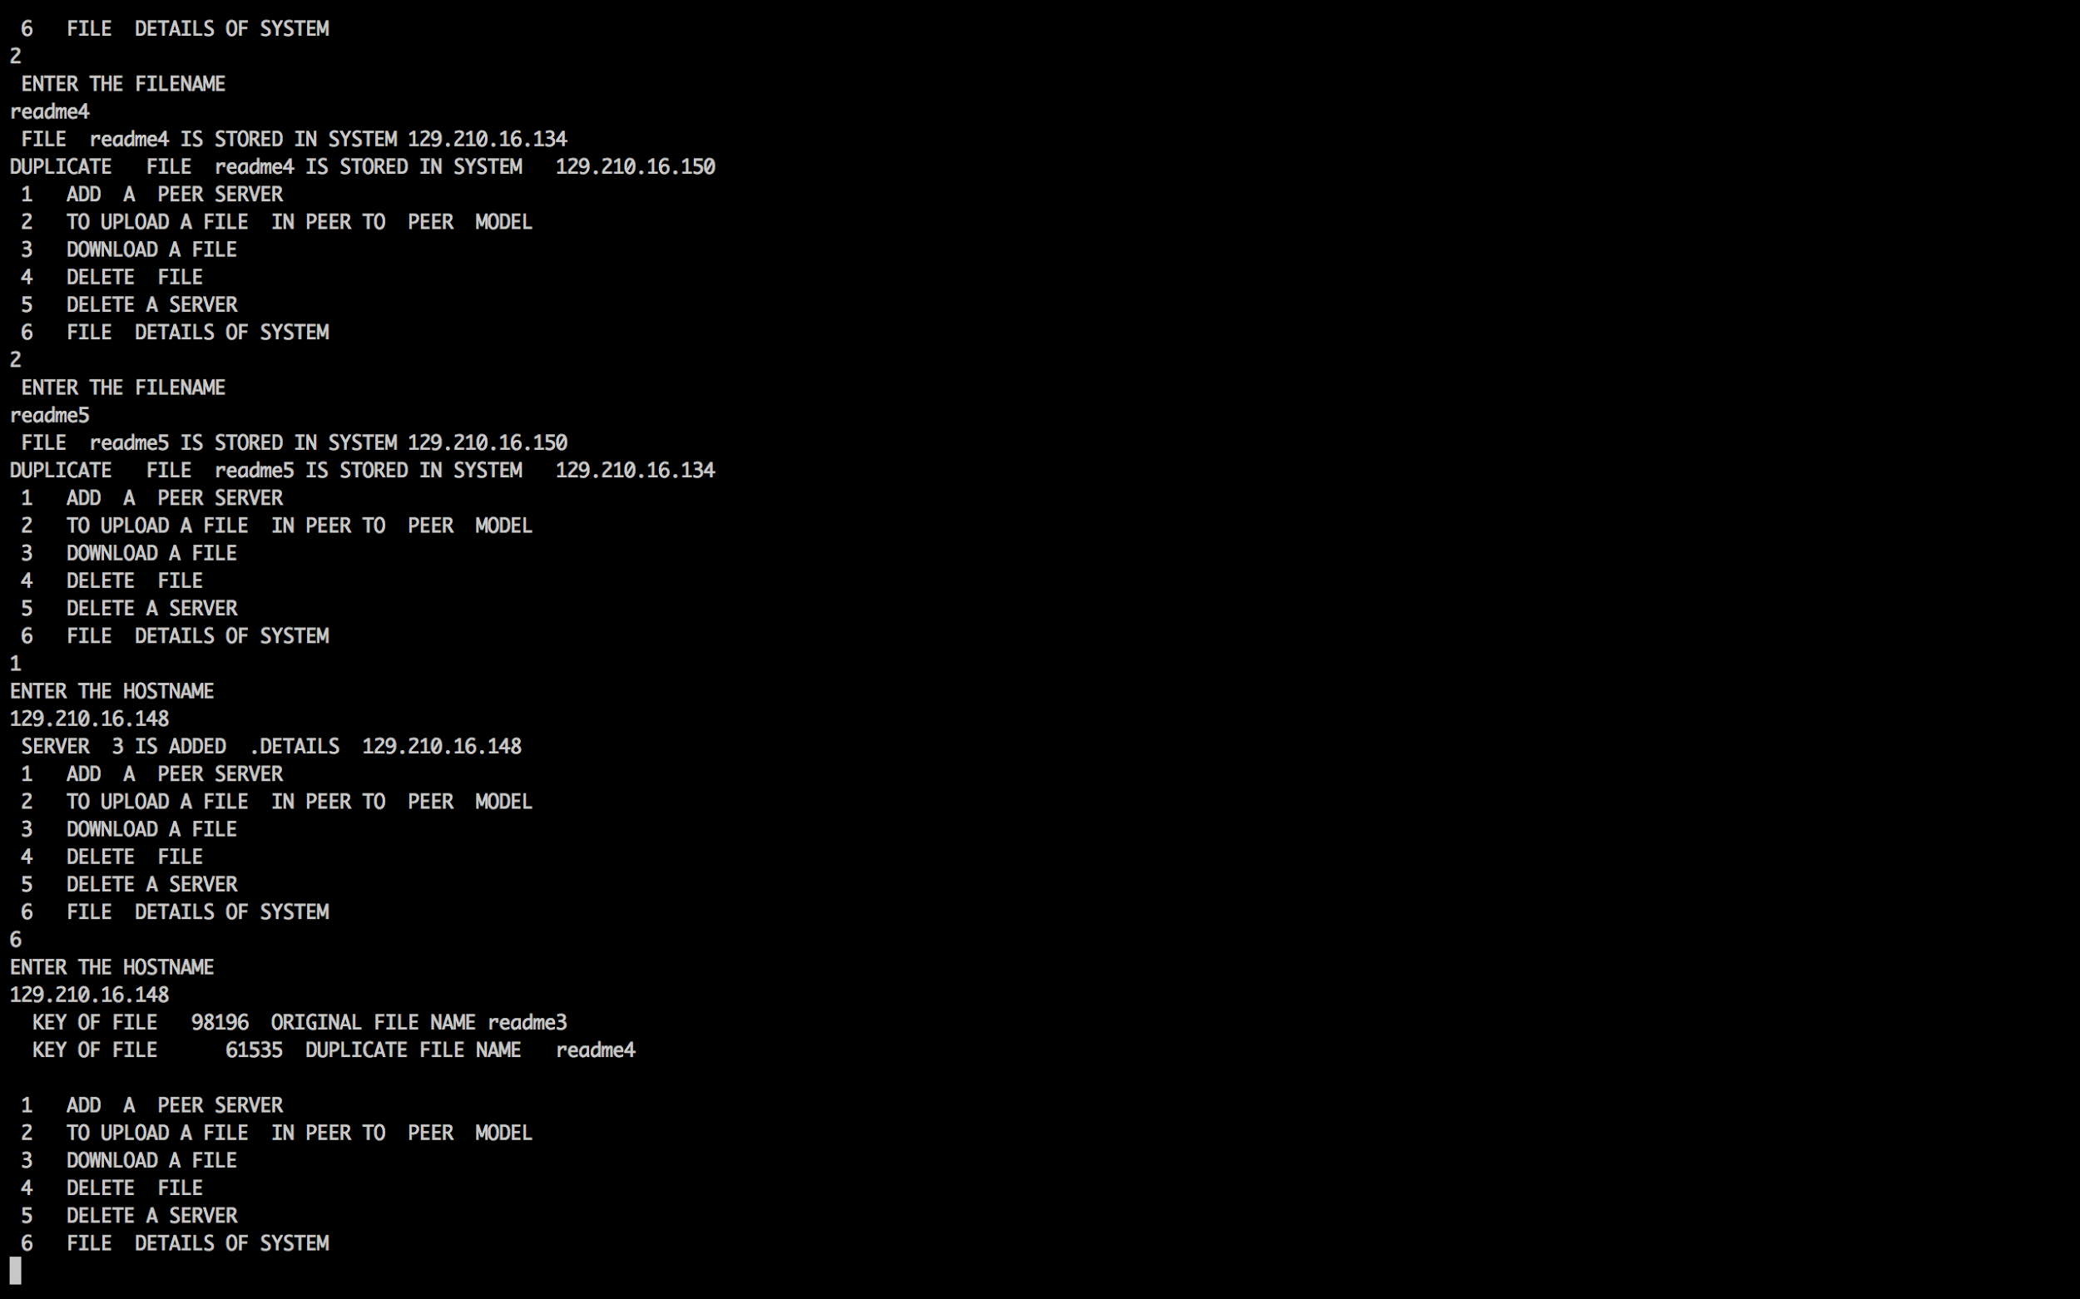

Slide 16
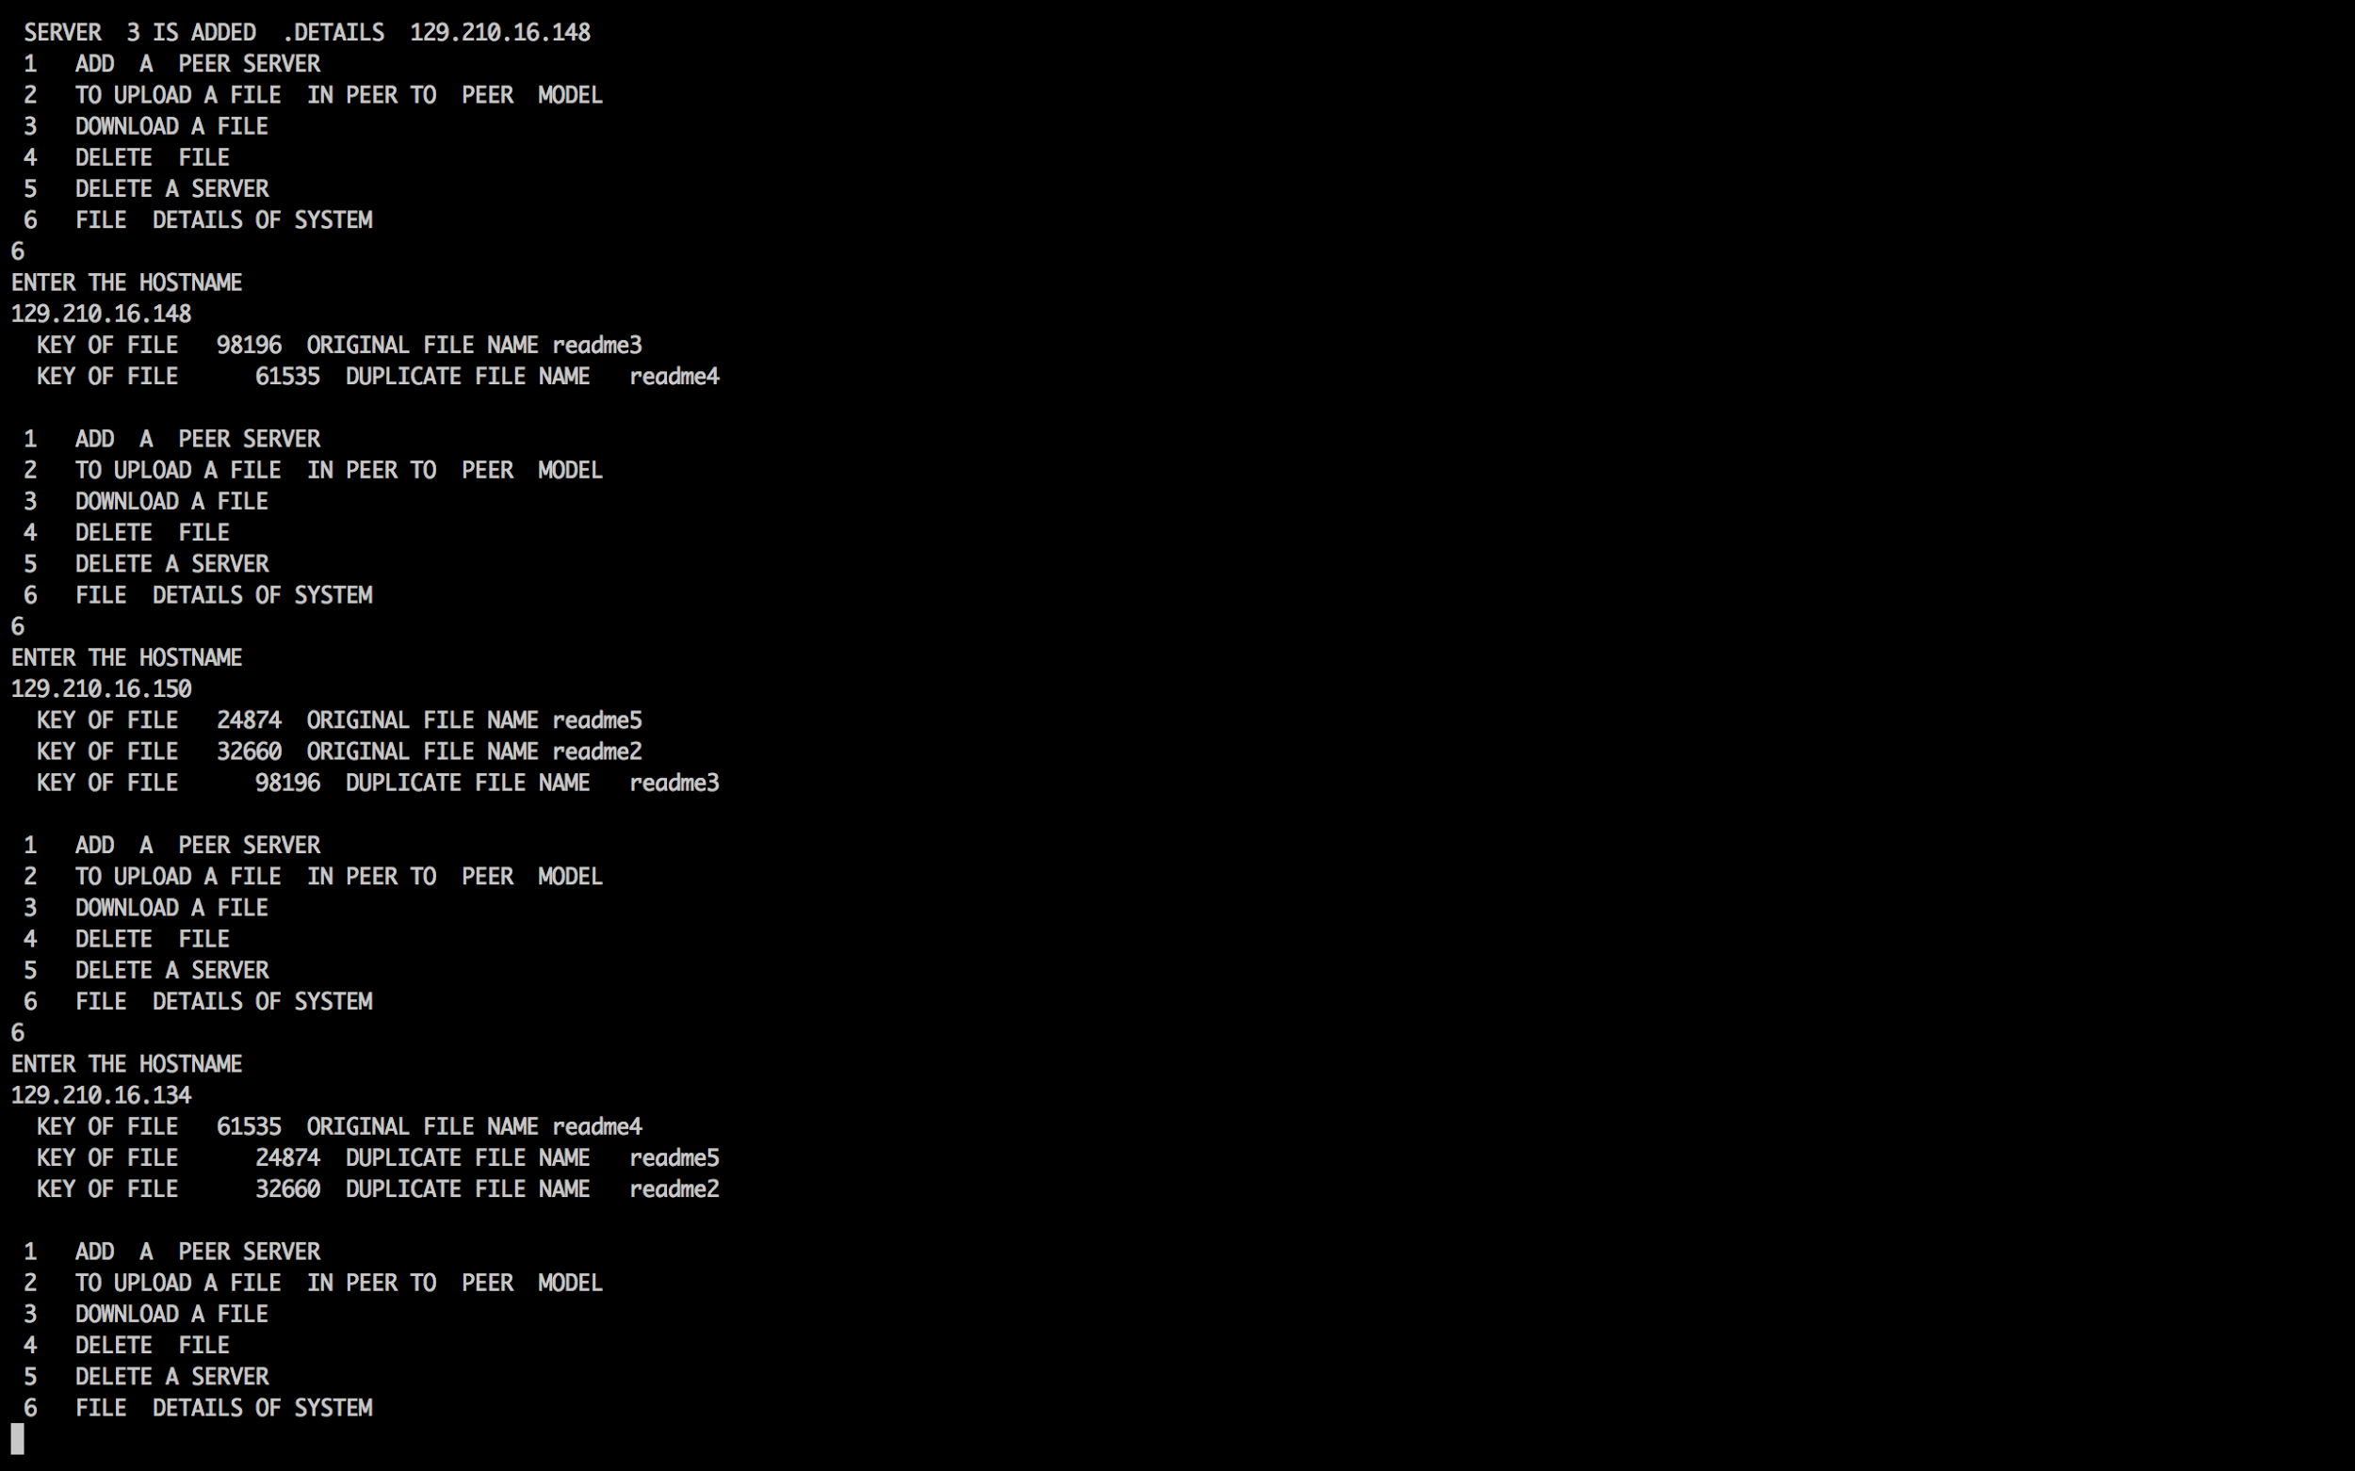

Slide 17

Thank You

